Slide 1
LASS: Location Aware Shelf System
ENGO500 - GIS & Land Tenure 2
Kathleen Ang Alexandra Cummins
Harshini Nanduri
Jeremy Steward
Ben Trodd
Notes:
Kathleen

Slide 2
Outline
Project overview (video)
Background about IoT, OGC
Project requirements and objectives
Overall development process
Prototype development
Server development
Website development
Notes:
Kathleen

Slide 3
Go watch video.
Video watch (placeholder)…
Notes:
Kathleen

Slide 4
Background

Slide 5
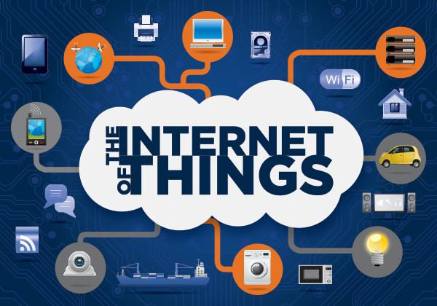
The Internet of Things (IoT)
Objects, animals or people are provided with unique identifiers and have the ability to automatically transfer data over a network
Networking everyday objects
Notes:
Ben
A scenario in which
...
without requiring human-to-human or human-to-computer interaction.
Some of these

Slide 6
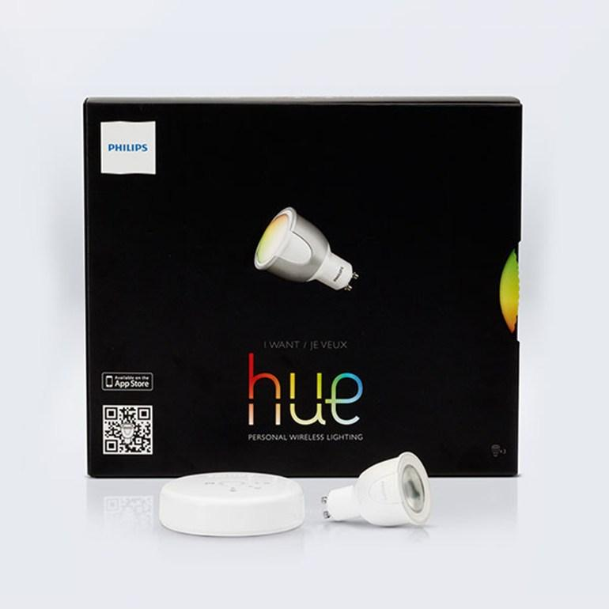
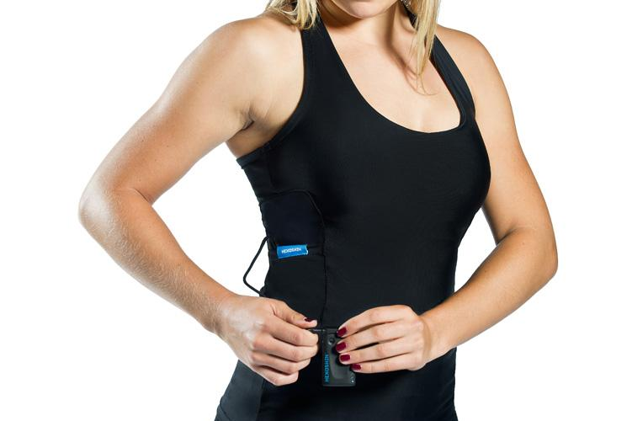
Internet of Things examples
Philips hue
Hexoskin

Slide 7

Open Geospatial Consortium (OGC)
Non-profit collaboration of more than 400 organizations
Open standards for geospatial services, data sharing and GIS data processing

Slide 8
Requirements and objectives

Slide 9
Project Requirements
Application based on “Internet of Things”
Utilize OGC SensorThings API
Free, Open Source Software
Notes:
H#1

Slide 10
Project Objectives
Common problem with IoT applications is the proprietary nature of their software
Results in buyer lock in
Difficult to use various IoT systems in tandem
Defeats the purpose of IoT ecosystem
Notes:
Alex
major components of IoT
“Thing” that will be connected through internet
Interface to interact with object
System to allow “thing” and interface to communicate

Slide 11
Project Objectives
Results in the following rationale behind the OGC SensorThings API:
“An OGC candidate standard for providing an open and unified way to interconnect IoT devices, data, and applications over the Web.”

Slide 12
Project Objectives
With this in mind we developed a few key objectives:
Our ‘Thing’ needed software which allowed sensors to communicate with the SensorThings API, and
An interface in the form of a website that allowed users to interact with the system

Slide 13
Development process

Slide 14
Development process
We determined what our system is and what we want it to do → value of our system.
What are the requirements of such a system?
How do we implement those requirements?
Notes:
Jimery

Slide 15
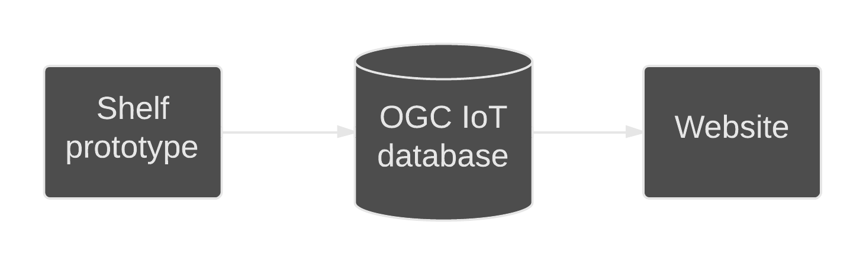
High level overview
Notes:
Jimery

Slide 16
Requirements for Sensor Prototype
Functional Requirements
Determine if there is product or not on the shelf
Determine if there is a customer in front of the shelf or not
The final system prototype should be similarly sized to existing shelves
The system should not fail if internet connectivity is lost

Slide 17
Requirements for Sensor Prototype
Non-Functional Requirements
Should conform to the OGC SensorThings API standard
The system should assume that a stable internet connection is available
Power to the system should be assumed. We specced the approx. power to be about 700mA/5V

Slide 18
Requirements for Website
Functional Requirements
Pull shelf stock measurements in real-time, so users can see where the store needs to be restocked
Track customers traveling through aisles in the store
The website should generate basic analytics from the sensor data

Slide 19
Requirements for Website
Non-Functional Requirements
The system should be easy to introduce and sign up for (e.g. such as signing up for Github or Twitter)
Should be secure to prevent unauthorized access
Shouldn’t fail if the store is not producing observations (e.g. in the event of a power loss)
Should be interoperable with the OGC SensorThings API

Slide 20
Development process: use cases

Slide 21
Use Cases: Definition
Use Cases are a way of defining the input and output relationships of actors and elements in a system
If our project objectives are our goals, and our requirements are what the system needs to do to meet those goals, then our Use Cases are how we’ll accomplish those goals

Slide 22
Recall

Slide 23
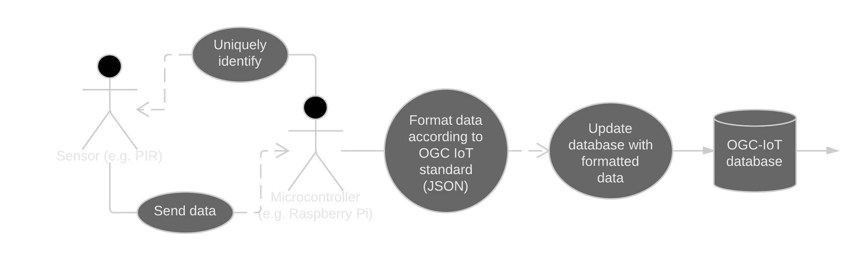
Sensor Prototype Use Cases
Notes:
1.1 - Update the database with formatted data
1.2 - Format data according to the OGC IoT Standard
1.3 - Identify sensors
1.4 - Send data to the micro-controller

Slide 24
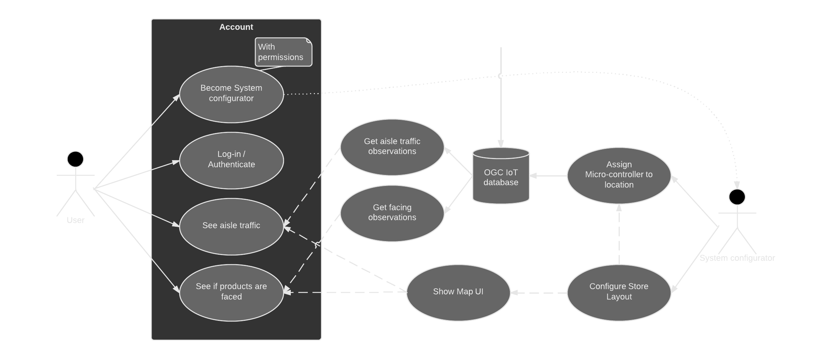
Website Use Cases

Slide 25
Prototype development

Slide 26
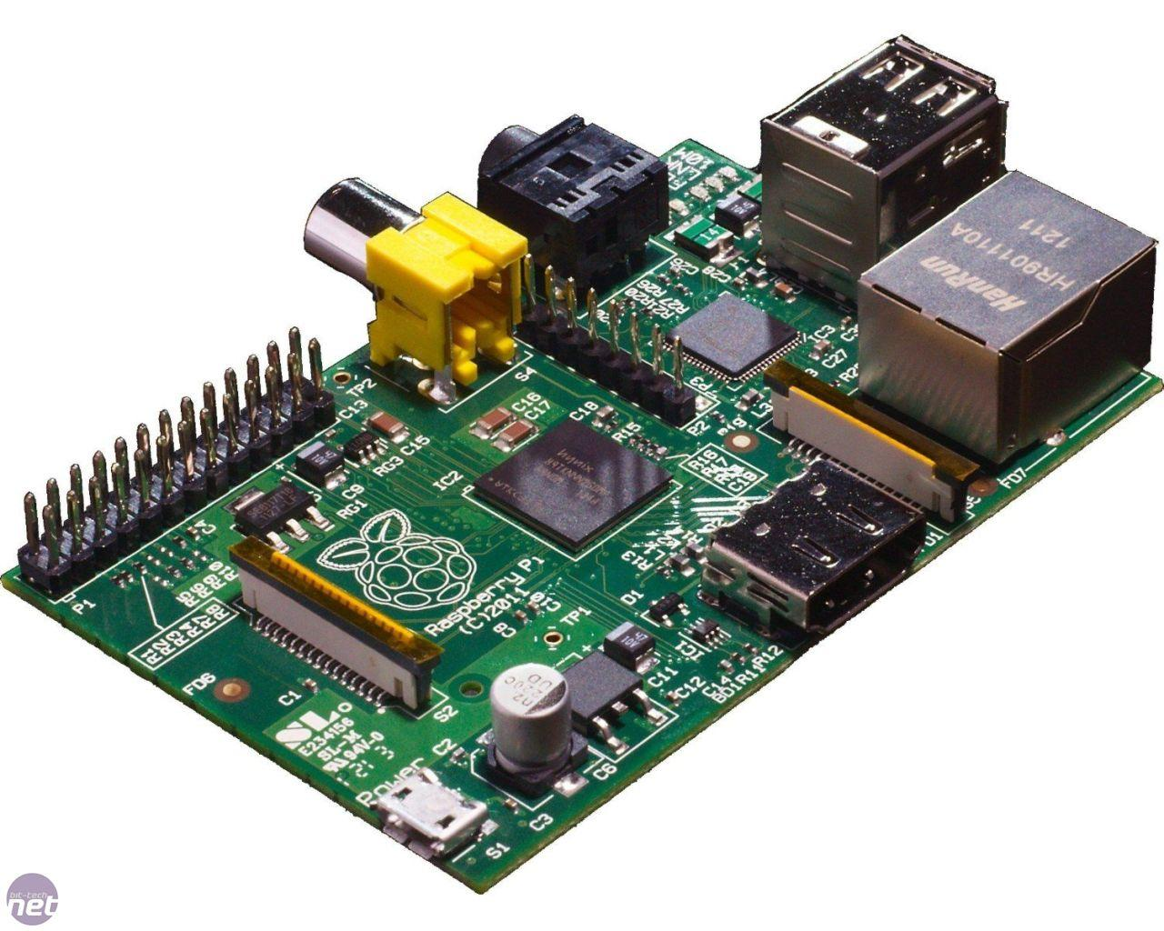
Equipment
Microcontroller: Raspberry Pi
Sensors Used:
PIR Motion Sensor
Photo Interrupter
Notes:
H#2

Slide 27
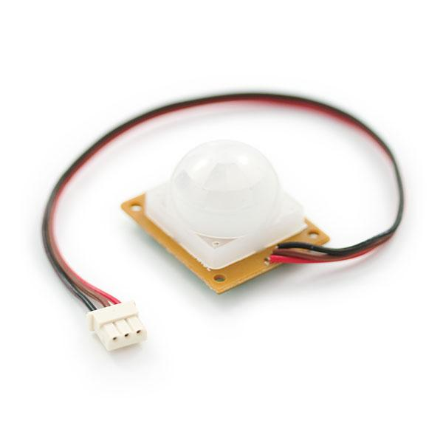
PIR Motion Sensor
Measures infrared light radiating from objects within view of the sensor (motion detectors)
Aim was to integrate these sensors within a shelf in a store, and track customers throughout the store
Issue: Extremely sensitive to the point that it would be constantly triggered by nothing at all

Slide 28
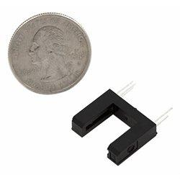
Photo Interrupter
Used to detect shelf facing
Works by shooting a beam of light between the prongs
Produces a true or false value depending on if the beam of light is blocked
When an object is placed between the prongs, the path of light gets blocked, and the detector reads 0
Notes:
(shown in the blank part of the u shaped device)

Slide 29
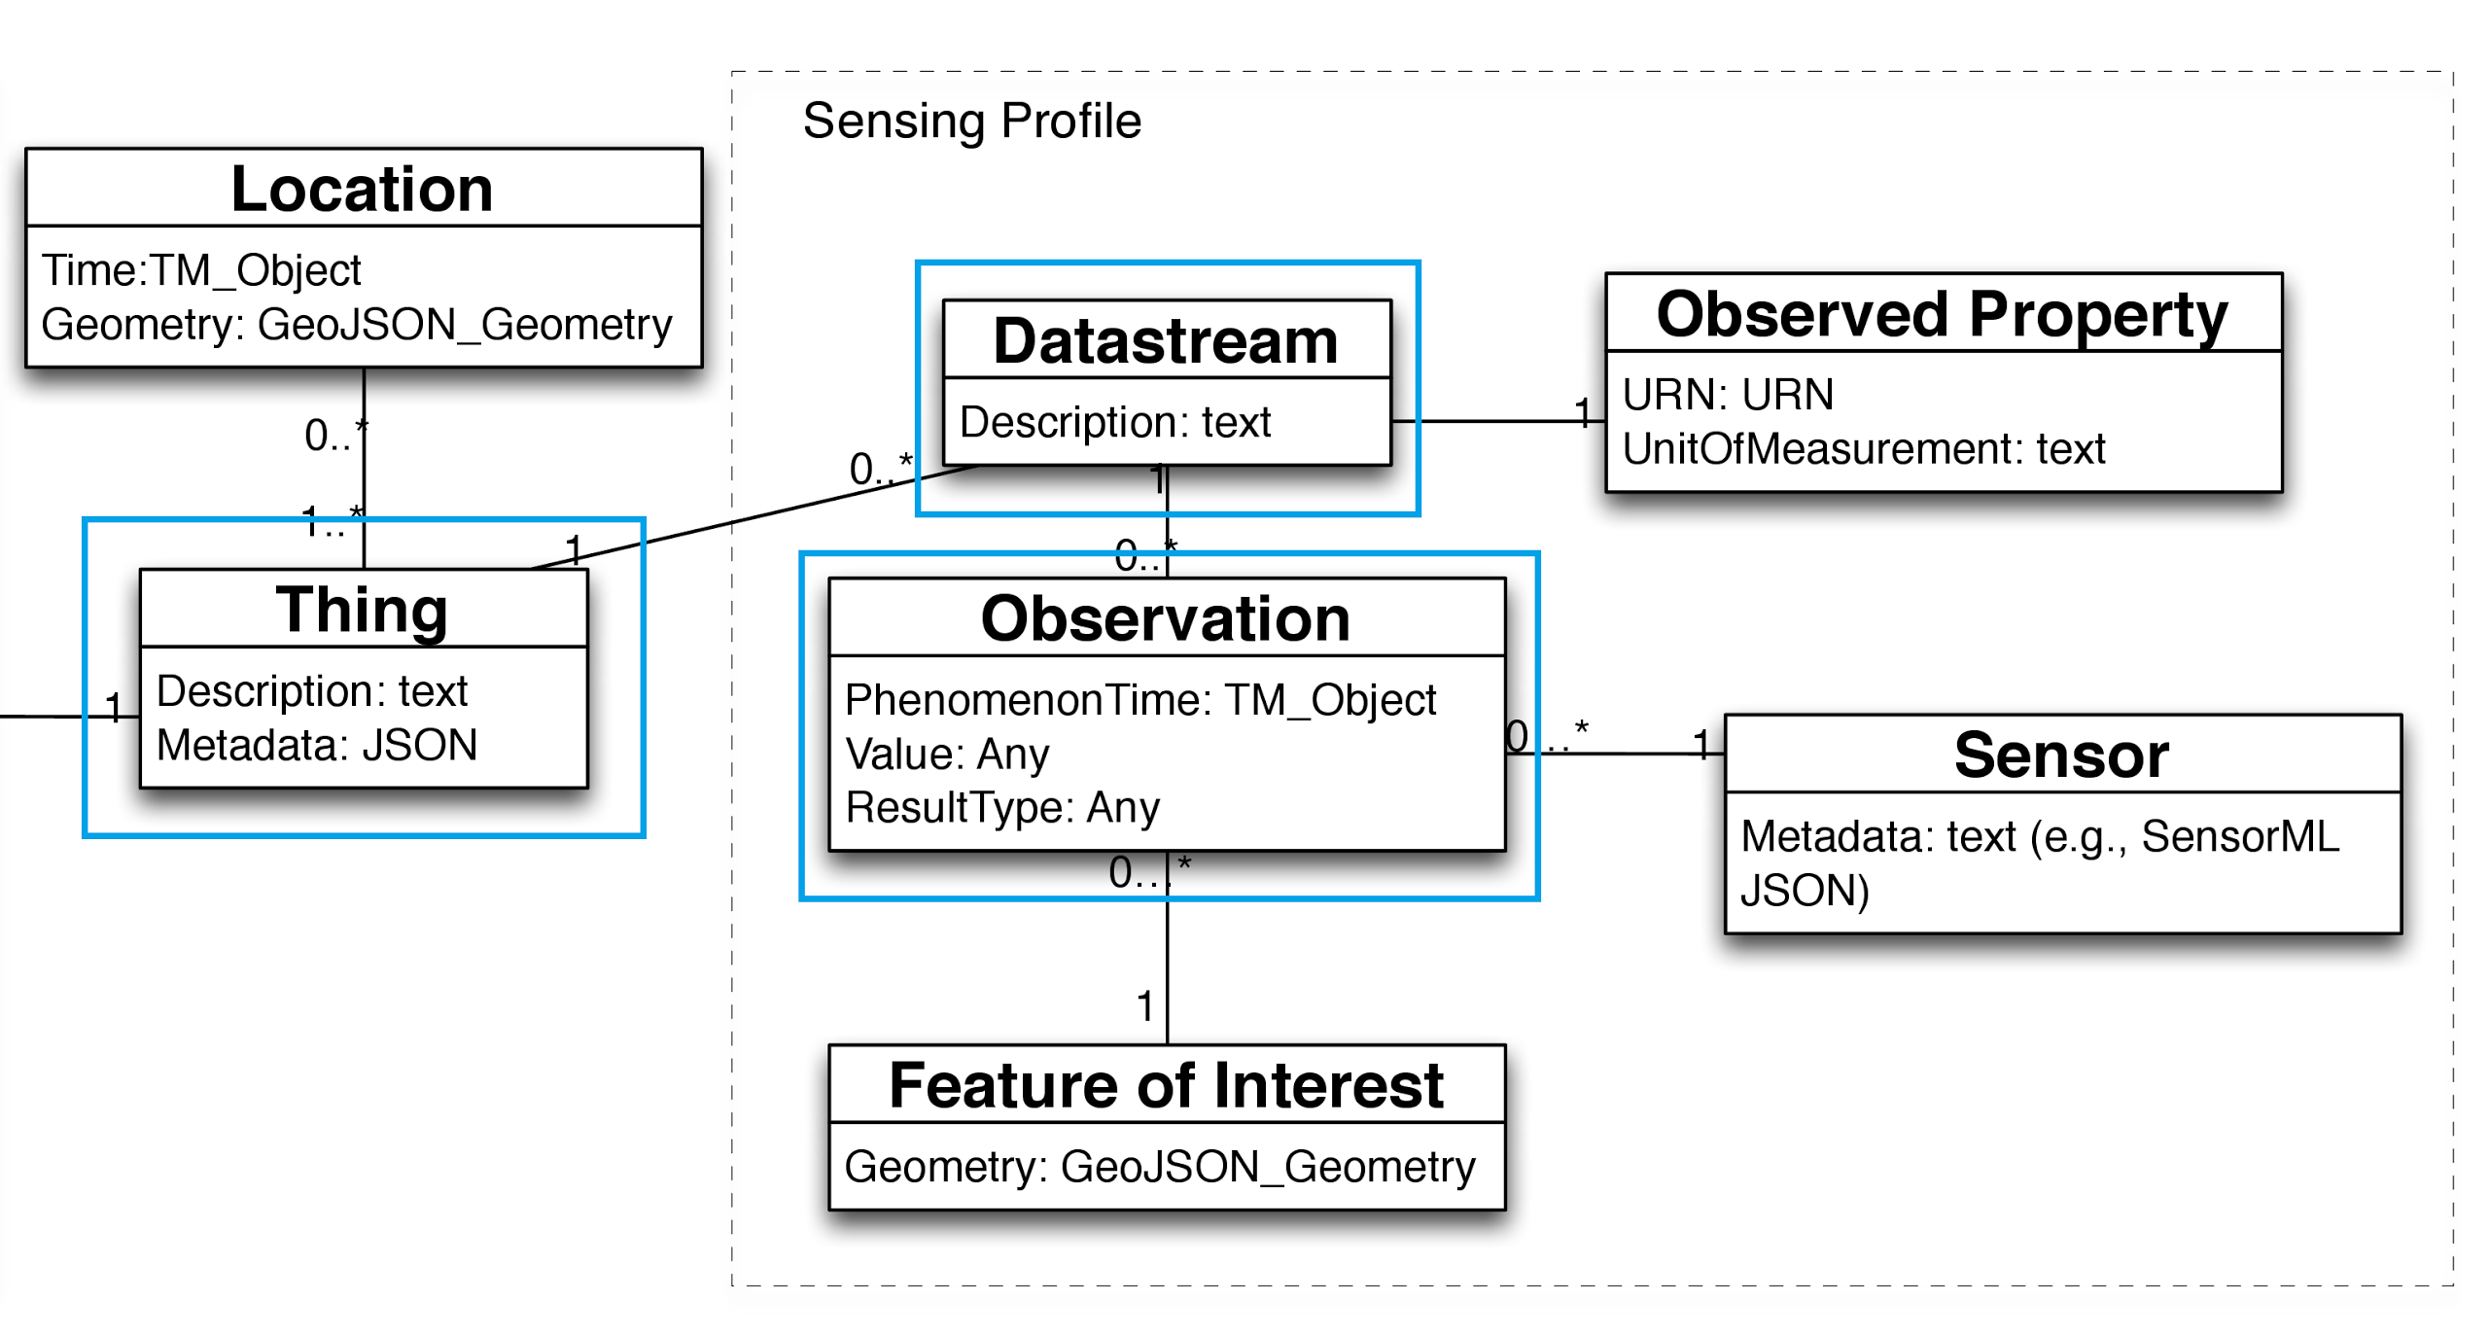
Data Model
Notes:
H#4

Slide 30
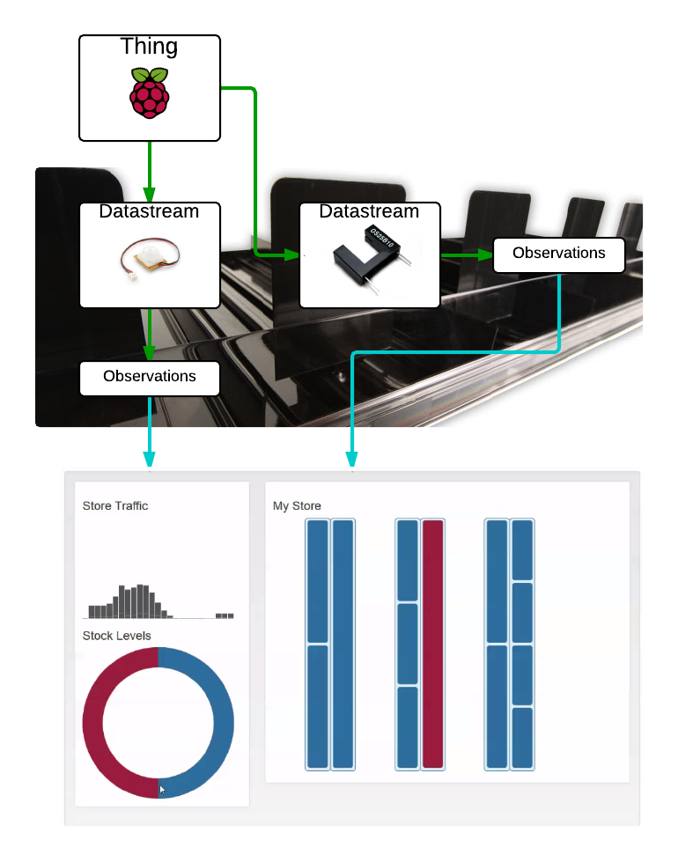

Slide 31
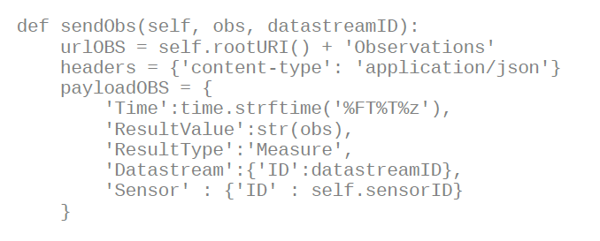
Fulfilling Use Cases
1.1 - Update the database with formatted data
1.2 - Format data according to the OGC IoT Standard

Slide 32
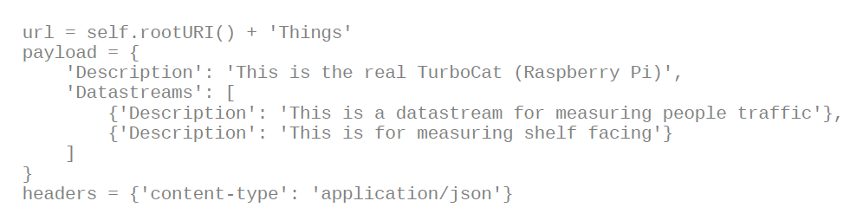
Fulfilling Use Cases
1.3 - Identify sensors
The sensors and microcontrollers were to be recognized and given a unique ID, so that their datastreams may be distinguished after the data is formatted and updated to the database (use cases 1.1 and 1.2).
Notes:
Completed during the creation of ‘thing’:
the microcontrollers were given their own names during set up, but were also assigned a specific object number as set out by the OGC SensrThingsAPI general data model. Each microcontroller became a separate ‘thing’ entity in the model. Each new datastream has a unique ID as well since they are elements in an array
here we see an object being created with two datastreams

Slide 33
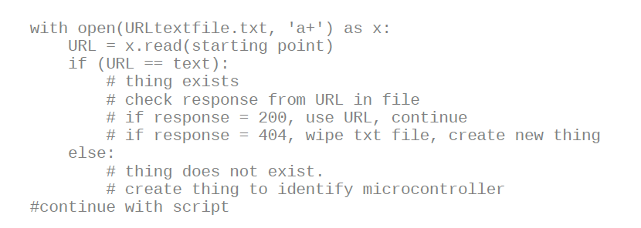
Fulfilling Use Cases
1.3 - Identify sensors
The sensors and microcontrollers were to be recognized and given a unique ID, so that their datastreams may be distinguished after the data is formatted and updated to the database (use cases 1.1 and 1.2).

Slide 34
Fulfilling Use Cases
1.4 - Send data to the micro-controller
Observations from the sensors will be acknowledged by the microcontroller and stored for use cases 1.2 and 1.3.
Completed through the functionality provided by the GPIO library and sensor functions.

Slide 35
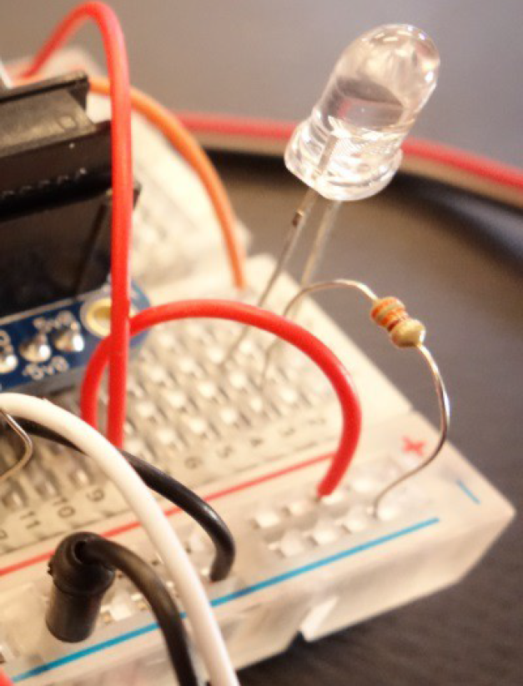
Prototype Usability
Run at boot time
LED

Slide 36
Server development

Slide 37
Webserver Development
Needed something to host pages for our site
The site would need to support both static and dynamic content
Needed to connect to a database of some kind to authenticate user sessions
Notes:
Jemery

Slide 38

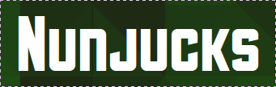

Technologies Used
Small server written in Node.js (with Express.js framework)
Developed site templates using Nunjucks Module for Node
MongoDB for our internal database (store user info)

Slide 39
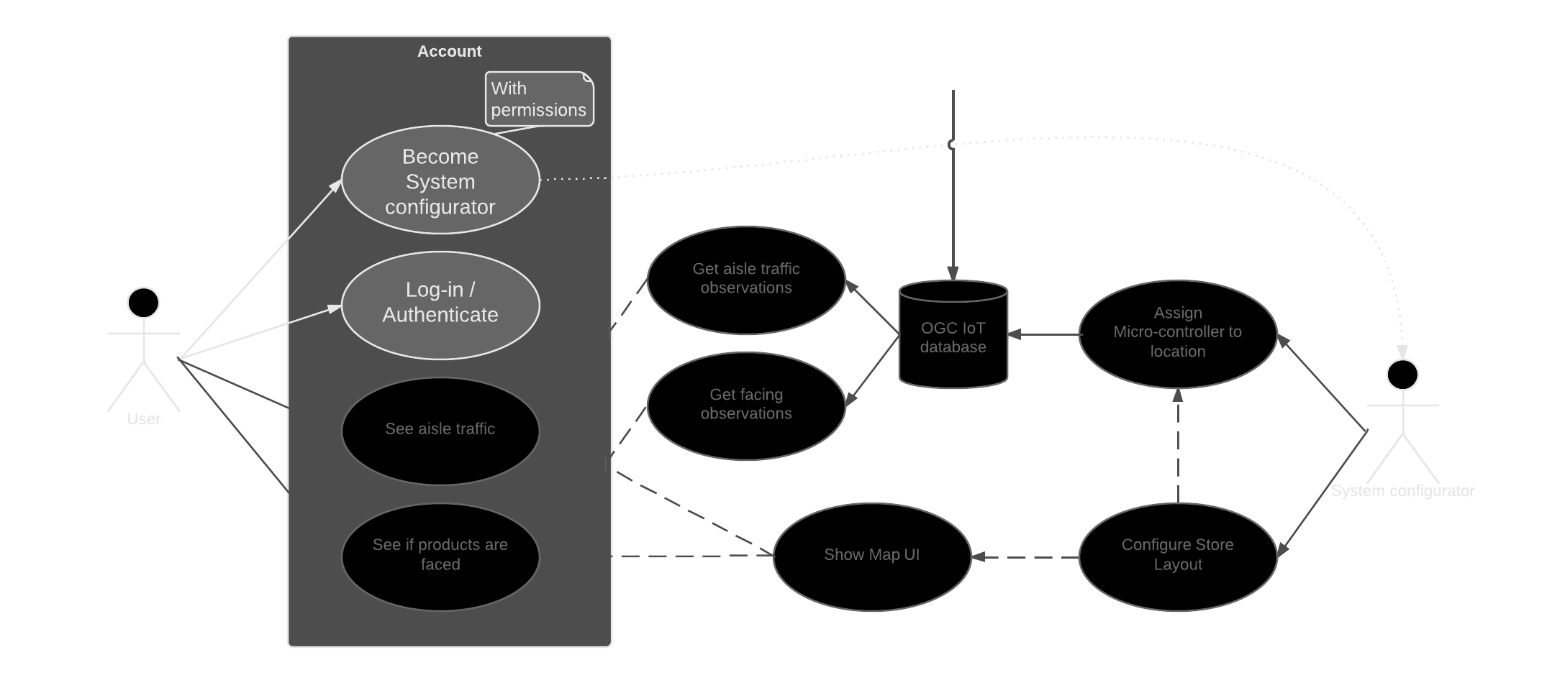
Use Cases Fulfilled

Slide 40
Website development

Slide 41
Overall Website
The website is how users set up and view the model of their store
Makes use of Bootstrap front-end framework
Notes:
Ben

Slide 42
Store Layout Creator
Sensors are set up, creating a model is the next step
Uses a combination of technologies:
jQueryUI
D3.js
X-editable
Notes:
Ben

Slide 43
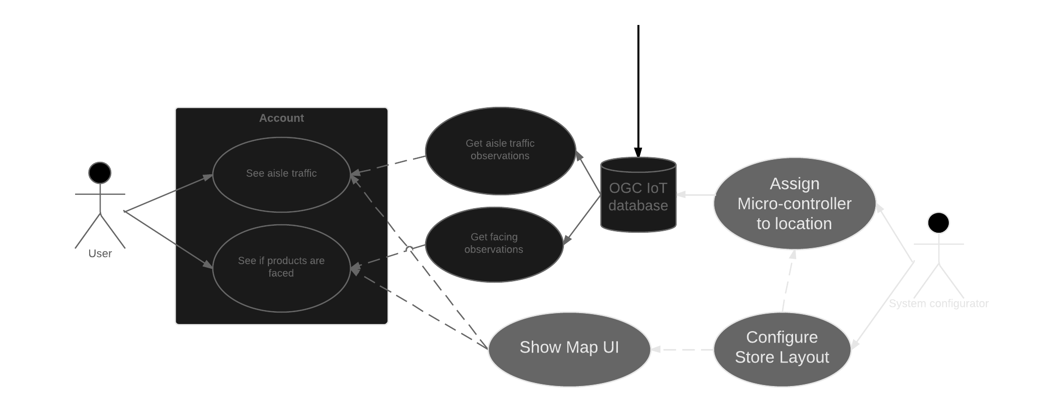
Store Layout Creator

Slide 44
Demo Time

Slide 45
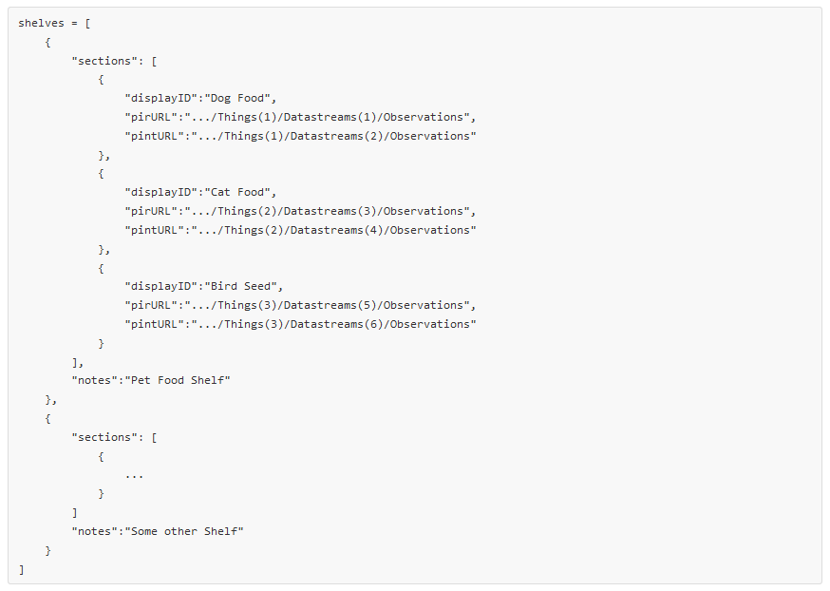
What gets saved
Data is saved as:
JSON

Slide 46
Store Viewer
Displays store observations on created map
Real-time
History
Uses similar technologies as store layout creator
jQueryUI
d3.js

Slide 47
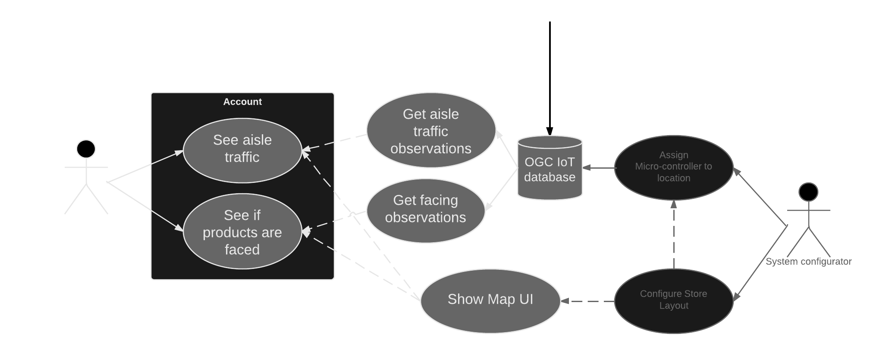
Store Viewer
Notes:
Kathleen

Slide 48
Store Viewer
Notes:
Kathleen

Slide 49
Store Viewer
Notes:
Kathleen

Slide 50
Store Viewer
Notes:
Kathleen

Slide 51
Demo time (again)

Slide 52
Conclusion
LASS fulfills the requirements of an open-source example of the OGC IoT API
LASS provides value to users by showing information about store traffic and stock levels

Slide 53

Questions?
Thanks for listening

